Slide 1

HR ANALYTICS
Unlocking Human Potential

Slide 2
AGENDA
1
OBJECTIVE
2
TOOLS USED
3
OVERVIEW
4
KPI’s ANALYSIS
5
DAHBOARDS
6
CONCLUSION

Slide 3
OBJECTIVE
The objective is to analyze data of 50,000 employees and attrition trends.
Explore Attrition Trends: Delve into historical data to uncover patterns and trends related to employee attrition within the organization.
Uncover Contributing Factors: Analyze data to identify key factors influencing attrition rates, shedding light on the underlying causes.
Enable Proactive Measures: Provide insights to empower management in taking proactive measures aimed at reducing attrition rates and fostering employee retention.

Slide 4




Tools used:
EXCEL
TABLEAU
POWER BI
MySQL

Slide 5




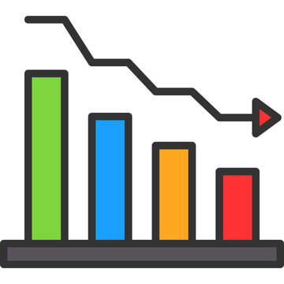
OVERVIEW
Total
Employees
50000
Active
Employees
24895
Average
Age
39 years
.
.
Attrition
Rate
50.21%
Total
Attrition
25105

Slide 6
KPI 1:Department-wise Attrition
Research and Development has high attrition rate with 51.21% whereas Hardware has low attrition rate with 49.44%.
Foster a culture that values and rewards innovative ideas, providing an environment where employees feel their contributions make a significant impact.
With a 51.21% attrition rate in Research and Development versus 49.44% in Hardware, fostering an innovative culture is vital. Creating an environment where employees feel their ideas matter can boost satisfaction and retention, addressing attrition challenges in R&D.

Slide 7
KPI 2: Attrition rate Vs Monthly income stats
Sales department has higher avg monthly income of 26,119 with least attrition rate of 50.02% whereas R&D department has avg monthly income of 25,796 with attrition rate of 51.21%.
Consider revisiting compensation structures in the R&D department to align with the higher attrition rate and explore opportunities for income enhancement.
Despite the Sales department's higher average monthly income and lower attrition, addressing compensation differentials in the R&D department could contribute to better retention and overall workforce stability.

Slide 8
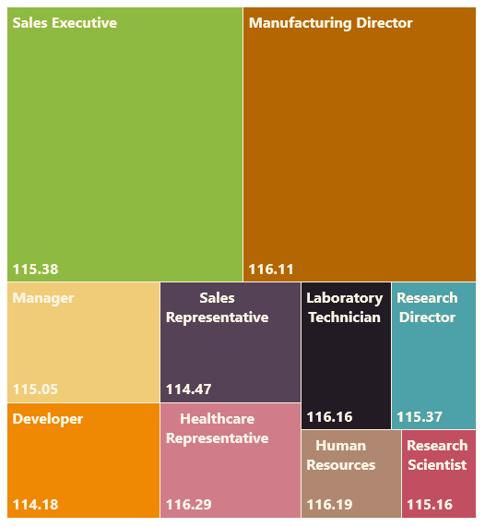
KPI 3: Average Hourly Rate of Male Research Scientist
Average hourly rate for male research scientist is 114.45.
Review and ensure that the average hourly rate for male research scientists remains competitive with industry standards to attract and retain top talent.
Maintaining a competitive average hourly rate for male research scientists is crucial for talent retention and ensuring the organization remains attractive in the competitive job market. Regularly assess and adjust compensation to align with industry benchmarks.

Slide 9

KPI 4: Average Working Years for each Department
Sales department has the highest average working years with 10.84 years whereas R&D department has the lowest average working years with 10.68 years.
Consider implementing professional development programs in the R&D department to enhance employee engagement and retention.
While the Sales department boasts higher average working years, introducing development initiatives in R&D can foster longevity and contribute to a more experienced and stable workforce.

Slide 10
KPI 5: Job Role vs Work-Life Balance
Research Scientists have the highest rating of work-life balance with 2.514 whereas Sales Executives have the lowest rating with 2.469.
Implement targeted work-life balance initiatives for Sales Executives to enhance overall job satisfaction.
While Research Scientists exhibit the highest work-life balance ratings, addressing specific concerns within the Sales Executive role can contribute to improved job satisfaction and well-being.

Slide 11
KPI 6: Attrition Rate vs Years since Last Promotion Relation
Employees who has not been promoted since last 20 years have high attrition rate whereas employees who has been promoted in between 11-20 years have low attrition rate.
Initiate career advancement programs for long-serving employees to mitigate attrition risk and boost job satisfaction.
The data suggests a correlation between promotions and attrition rates. Implementing programs for long-serving employees to advance in their careers could positively impact retention and overall workforce satisfaction.

Slide 12

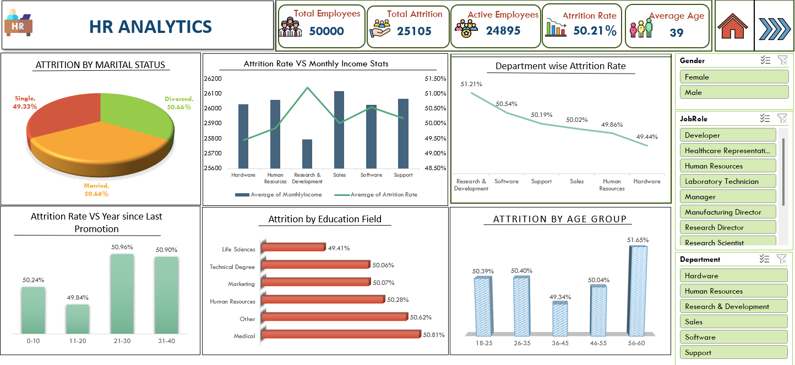
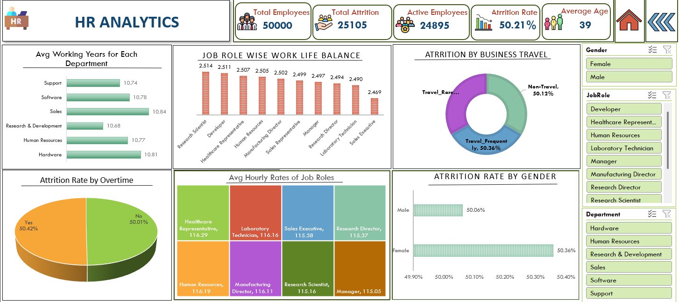

Slide 13

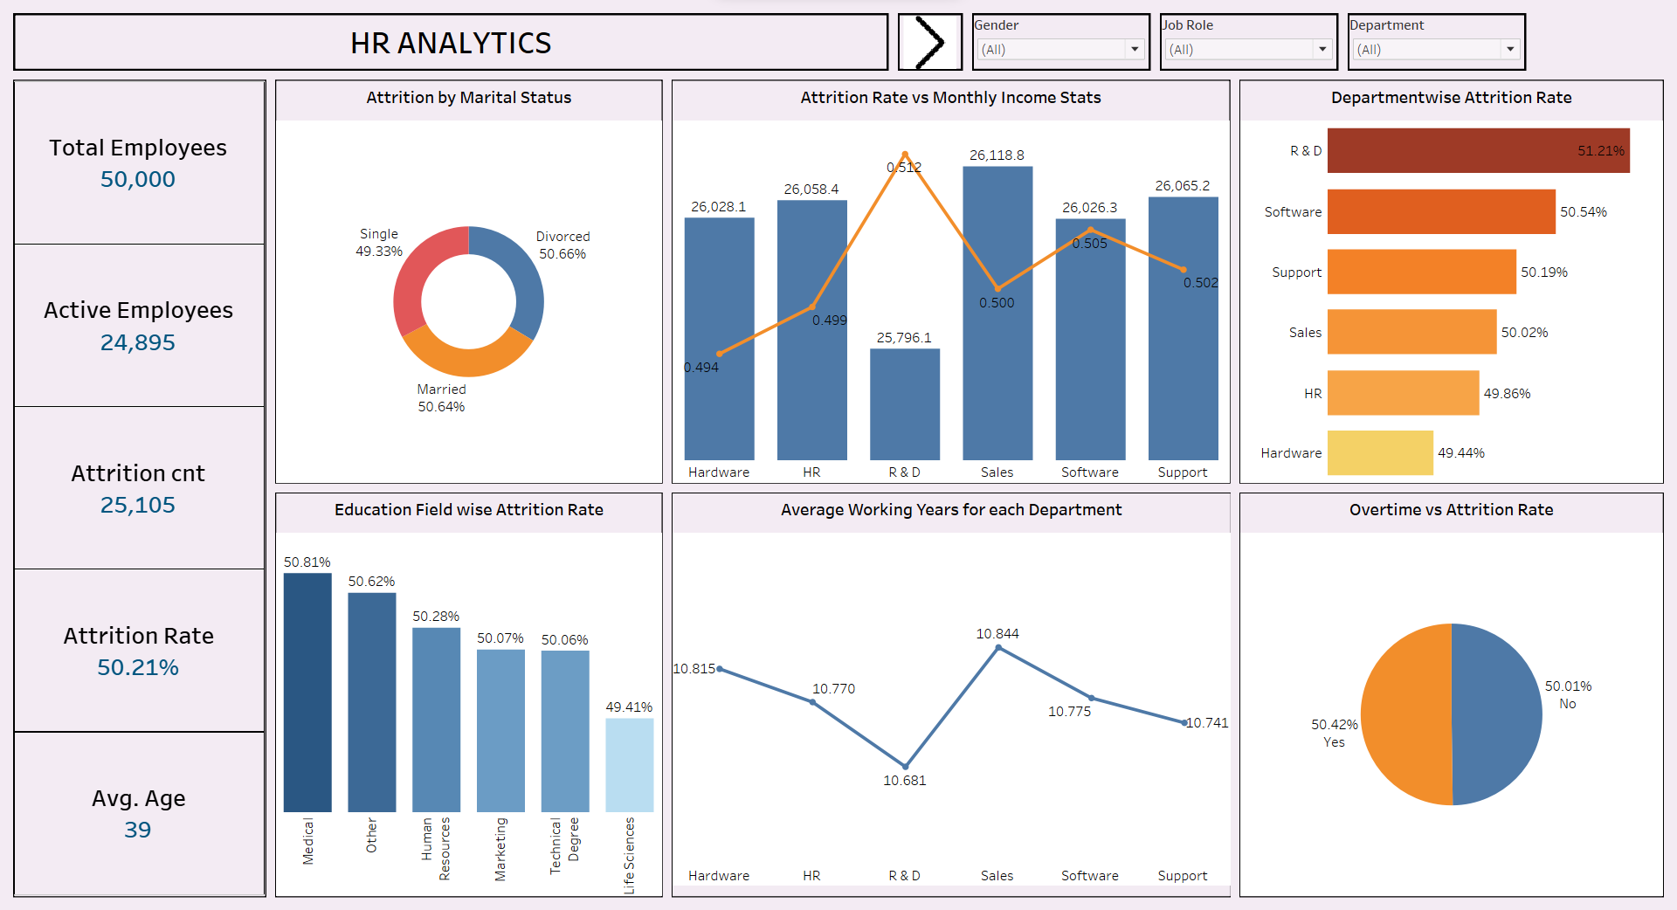
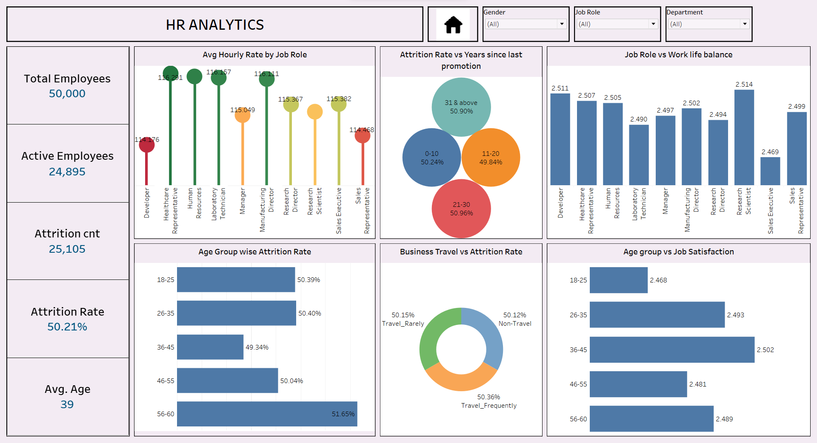

Slide 14

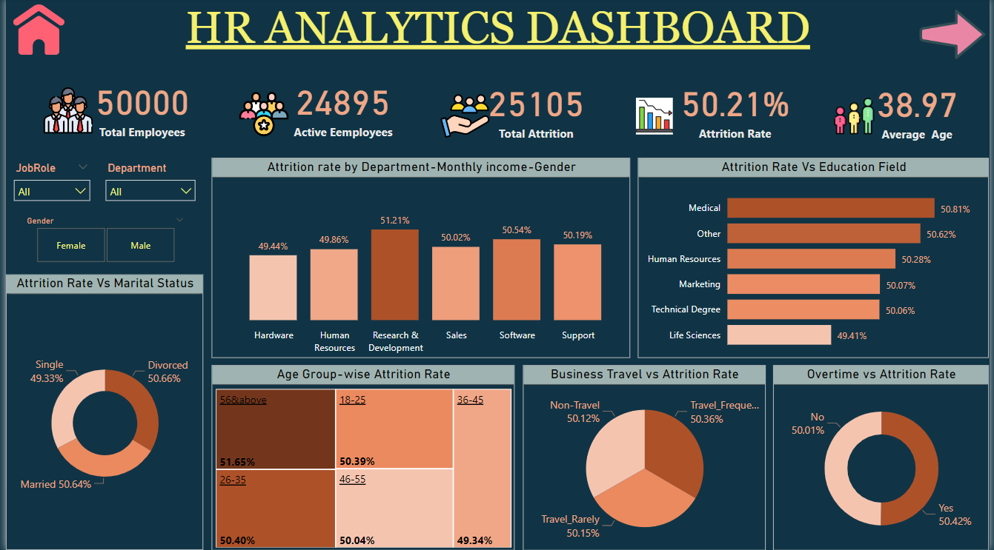
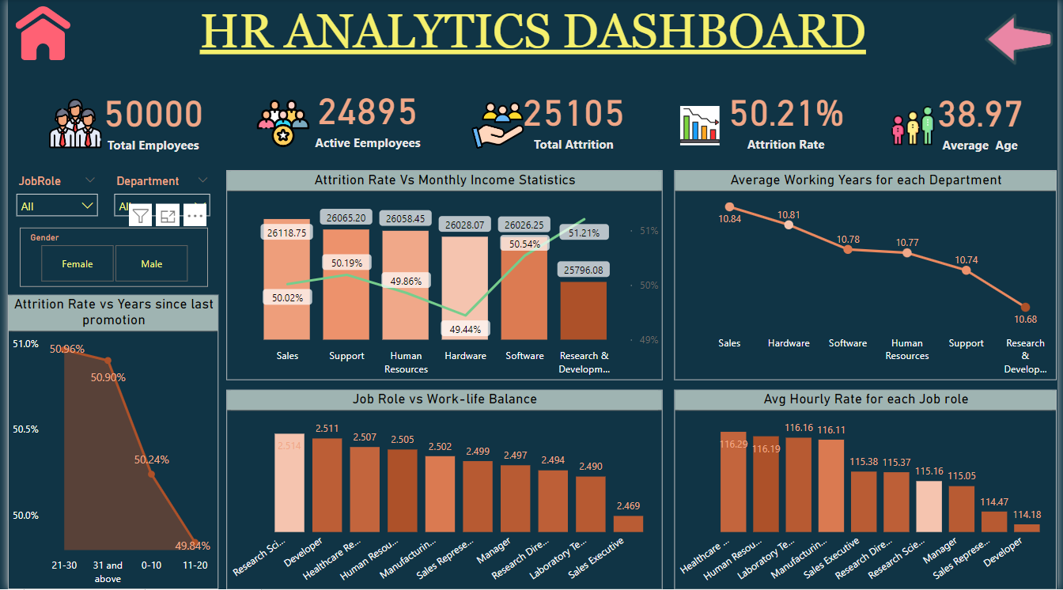

Slide 15

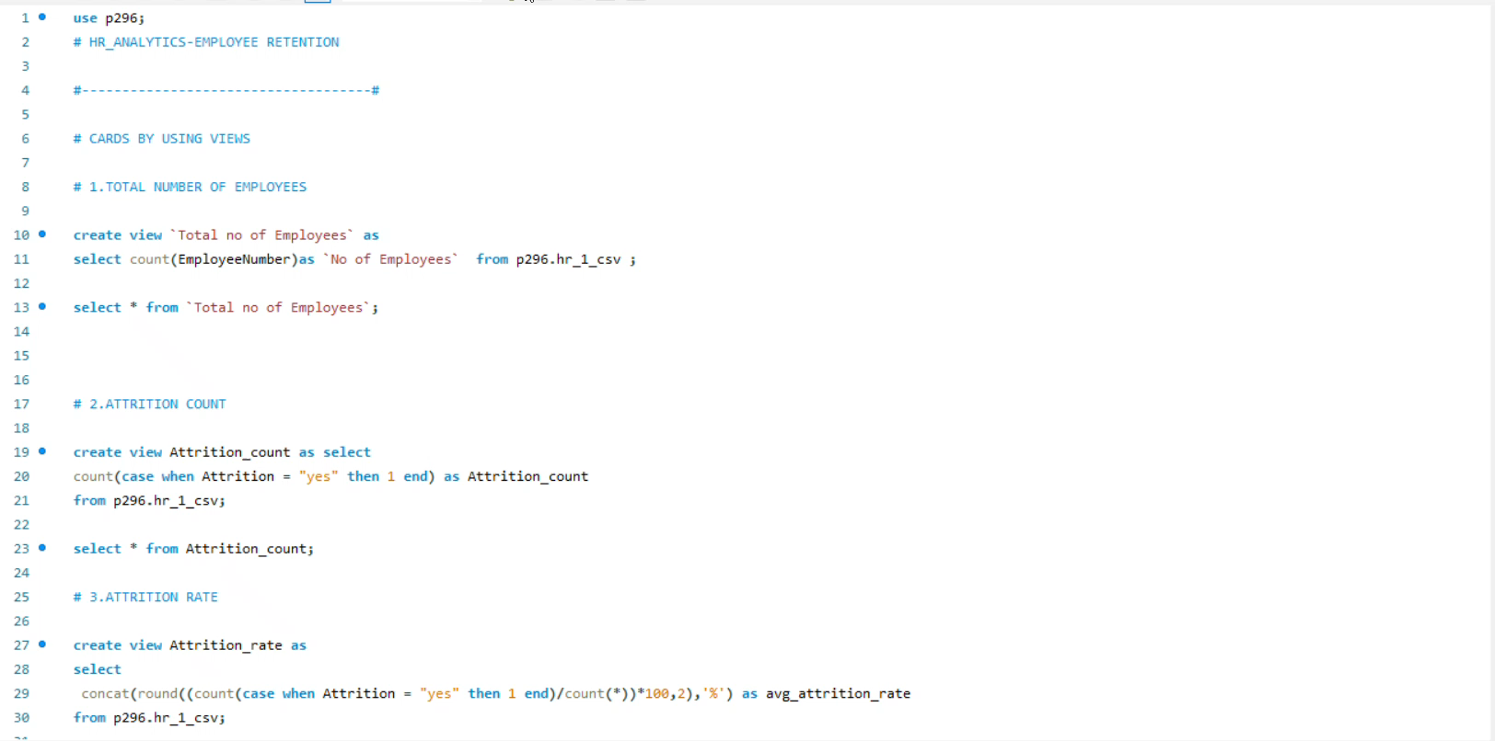

Slide 16
Conclusion
Strategic Decision Insights: The analysis of KPIs provides valuable insights guiding strategic HR decisions.
Foundation for Targeted Initiatives: Understanding attrition rates, hourly rates, and promotion timelines establishes a basis for implementing targeted HR initiatives.
Impact of Job Roles on Work-Life Balance: Recognizing the influence of job roles on work-life balance highlights the need for tailored policies.
Tenure Dynamics Awareness: Acknowledging the varying tenure dynamics in each department allows for more effective workforce planning.
Engagement and Stability Enhancement: The gathered insights aim to foster a more engaged and stable workforce through informed HR policies.

Slide 17

THANK YOU!

